Slide 1
PlaNet
Intern1의 논문 리뷰 1 Nov. 2020.
Learning Latent Dynamics
for Planning from Pixels

Slide 2
PlaNet Deep Planning Network
■ Scalable Model-based RL
■ Efficint planning in latent space with large batch size
■ Reaches top performance using 200X fewer episodes

Slide 3
PlaNet Deep Planning Network
■ Recurrent State Space Model (RSSM)
Deterministic & Stochastic Components
■ Latent Overshooting
Latent Space Result로 Latent Sequence Model을 굴리는게 장기예측에 적합

Slide 4
Recurrent State Space Model

Slide 5
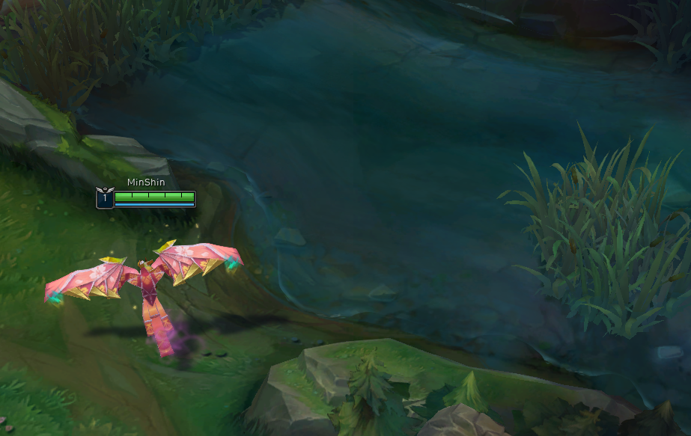
Recurrent State Space Model (RSSM)
보이는게 State의 전부가 아닐 수 있다. (Non-Marcov)
Partially Observable Markov Decision Process를 Marcov Decision Process로 바꾸는 기법
DQN에서는 비슷하게 이미지 네 장을 묶어 하나의 State로 취급하는 것과 유사하게
(Non-Marcov를 Marcov하게 바꾸는 기법으로 제시하는 것이다.

Slide 6
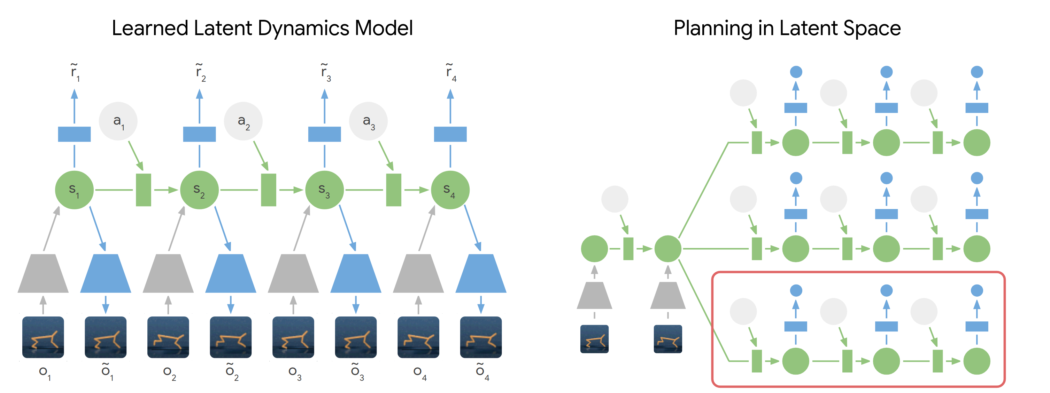
Recurrent State Space Model (RSSM)

Slide 7
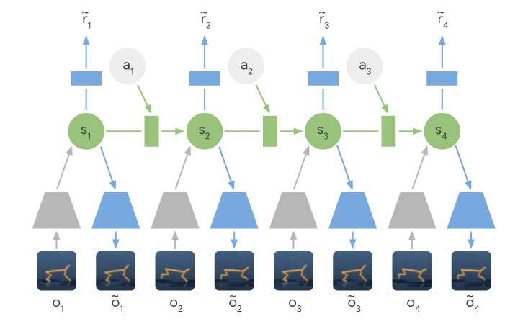
Recurrent State Space Model (RSSM)
■ Learned Latent Dynamics Model
Decode
Reward
저렴한
Hidden
State
Predict Space
Hidden State에 Image에 대한 Latent 정보가 잘
있도록 하는 디코더

Slide 8
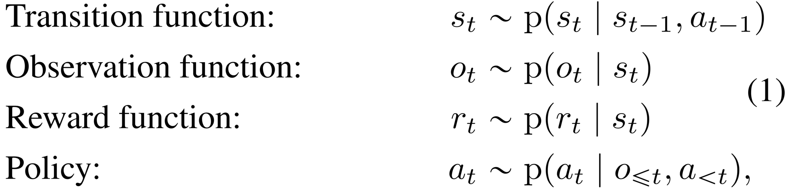
Recurrent State Space Model (RSSM)
■ Learned Latent Dynamics Model
Policy는?
Model-free처럼 Policy Net을 사용하는 게 아니고
굴려온 RNN이용해서 그때그때 Planning한다.

Slide 9
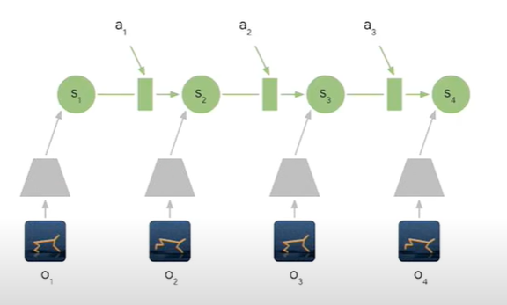
Recurrent State Space Model (RSSM)
■ Learned Latent Dynamics Model

Slide 10
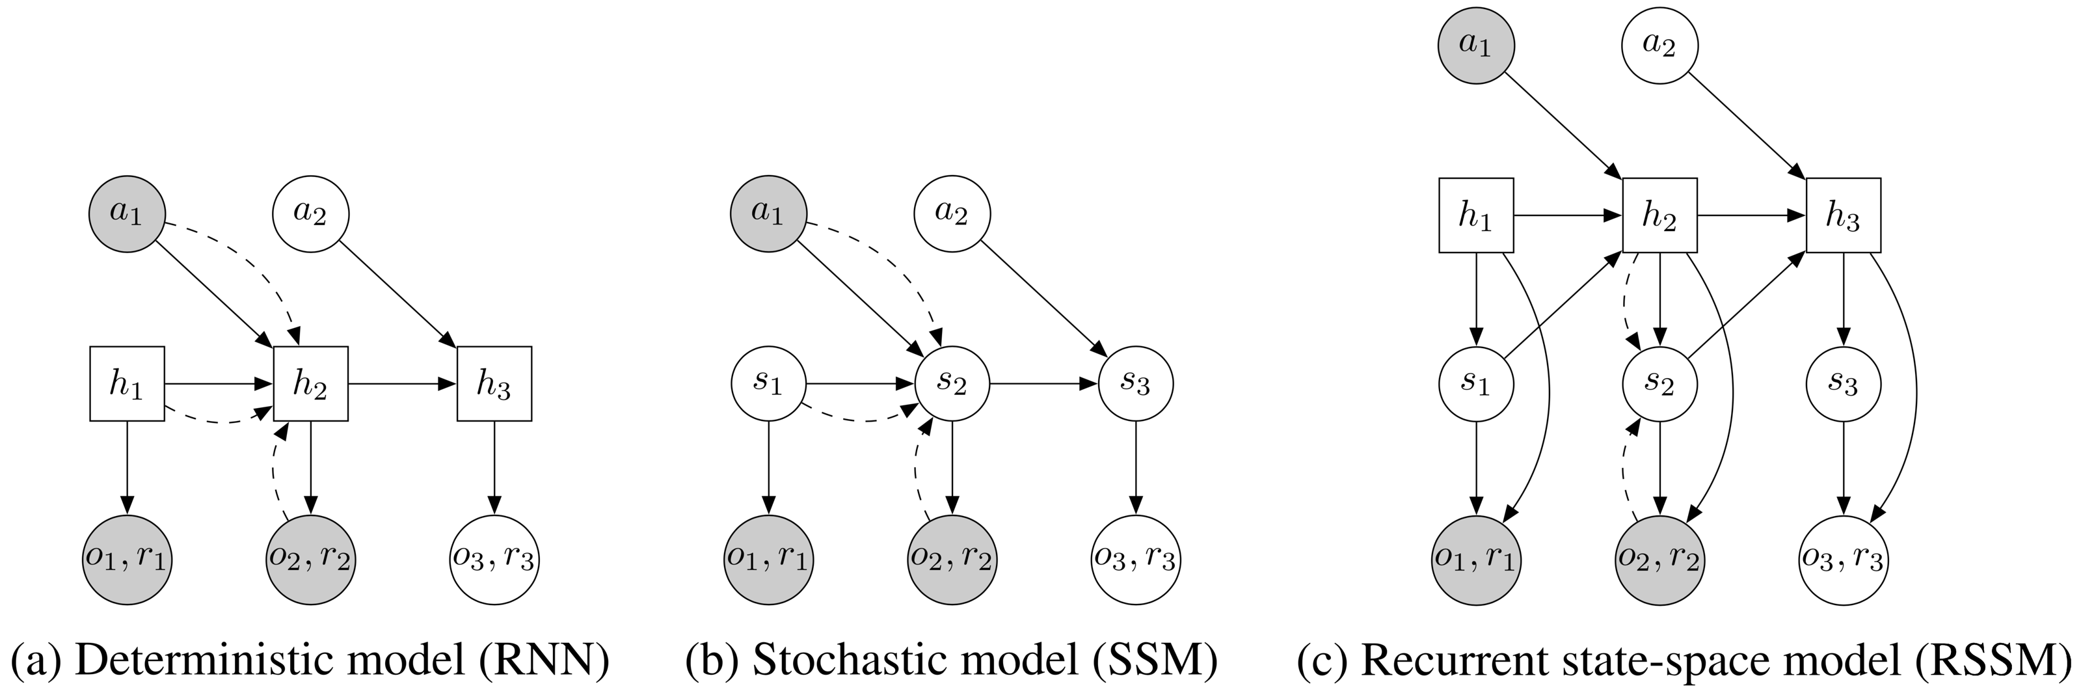
Recurrent State Space Model (RSSM)

Slide 11

Recurrent State Space Model (RSSM)
RSSM에서 State는 Deterministic & Stochastic Components 으로 이루어져 있다.
Deterministic
Components
Stochastic
Components
$t$
$s_{t}$
$o_{t}$
$a_{t}$
$r_{t}$
Discrete Time step
Hidden states
Image observations
Continuous action vectors
Scalar rewards

Slide 12
Recurrent State Space Model (RSSM)
Motivation
Deterministic
Stochastic transitions make it difficult for the transition model to reliably remember information for multiple time steps.
Stochastic
Split the state into stochastic and deterministic parts, allowing the model to robustly learn to predict multiple futures.
All information about the observations must pass through the sampling step of the encoder
to avoid a deterministic shortcut from inputs to reconstructions.
Detail

Slide 13
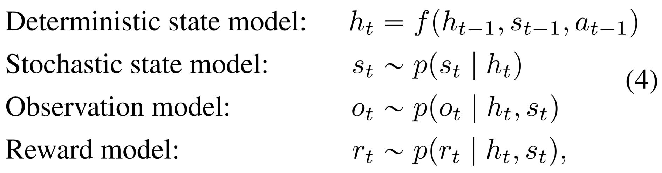
Latent Dynamics (PlaNet, Deep Planning Network)
■ Recurrent State Space Model (RSSM)

Slide 14
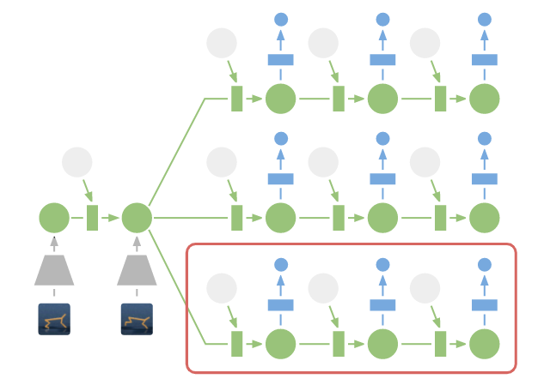
Latent Dynamics (PlaNet, Deep Planning Network)
■ Planning in Latent Space
Past
Experience
searches for the best sequence of future actions.

Slide 15
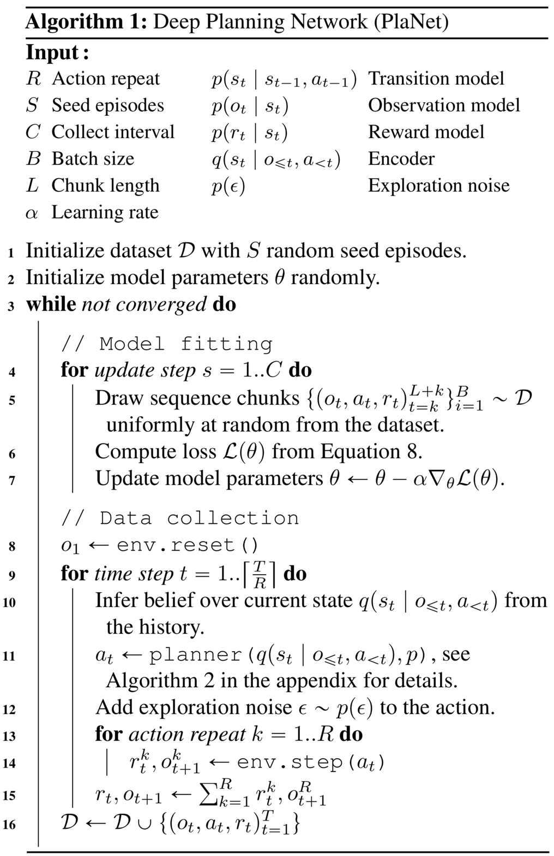
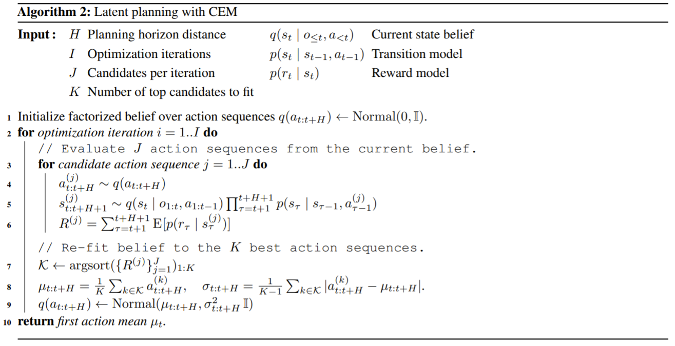
Latent Dynamics (PlaNet, Deep Planning Network)
PlaNet은 Planning을 위해
Cross Entropy Method (CEM) 을 사용했다.

Slide 16
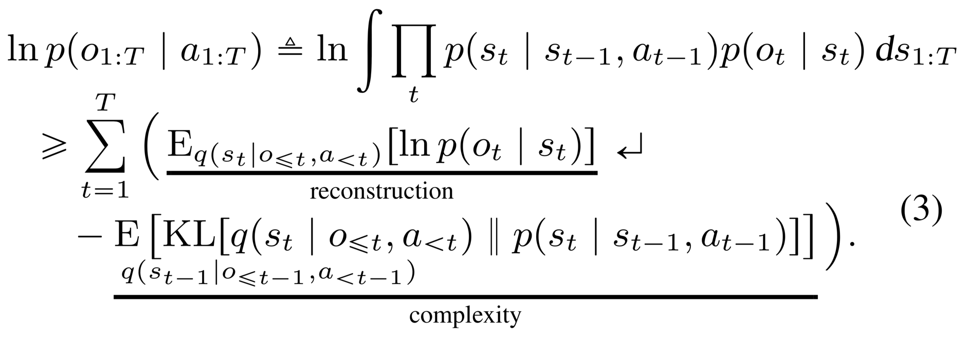
Latent Dynamics (PlaNet, Deep Planning Network)
■ Objective Function
Limitation
Gradient가 한 step만 흐르기 때문에, 1-step prediction만 보장한다

Slide 17
Latent Overshooting

Slide 18
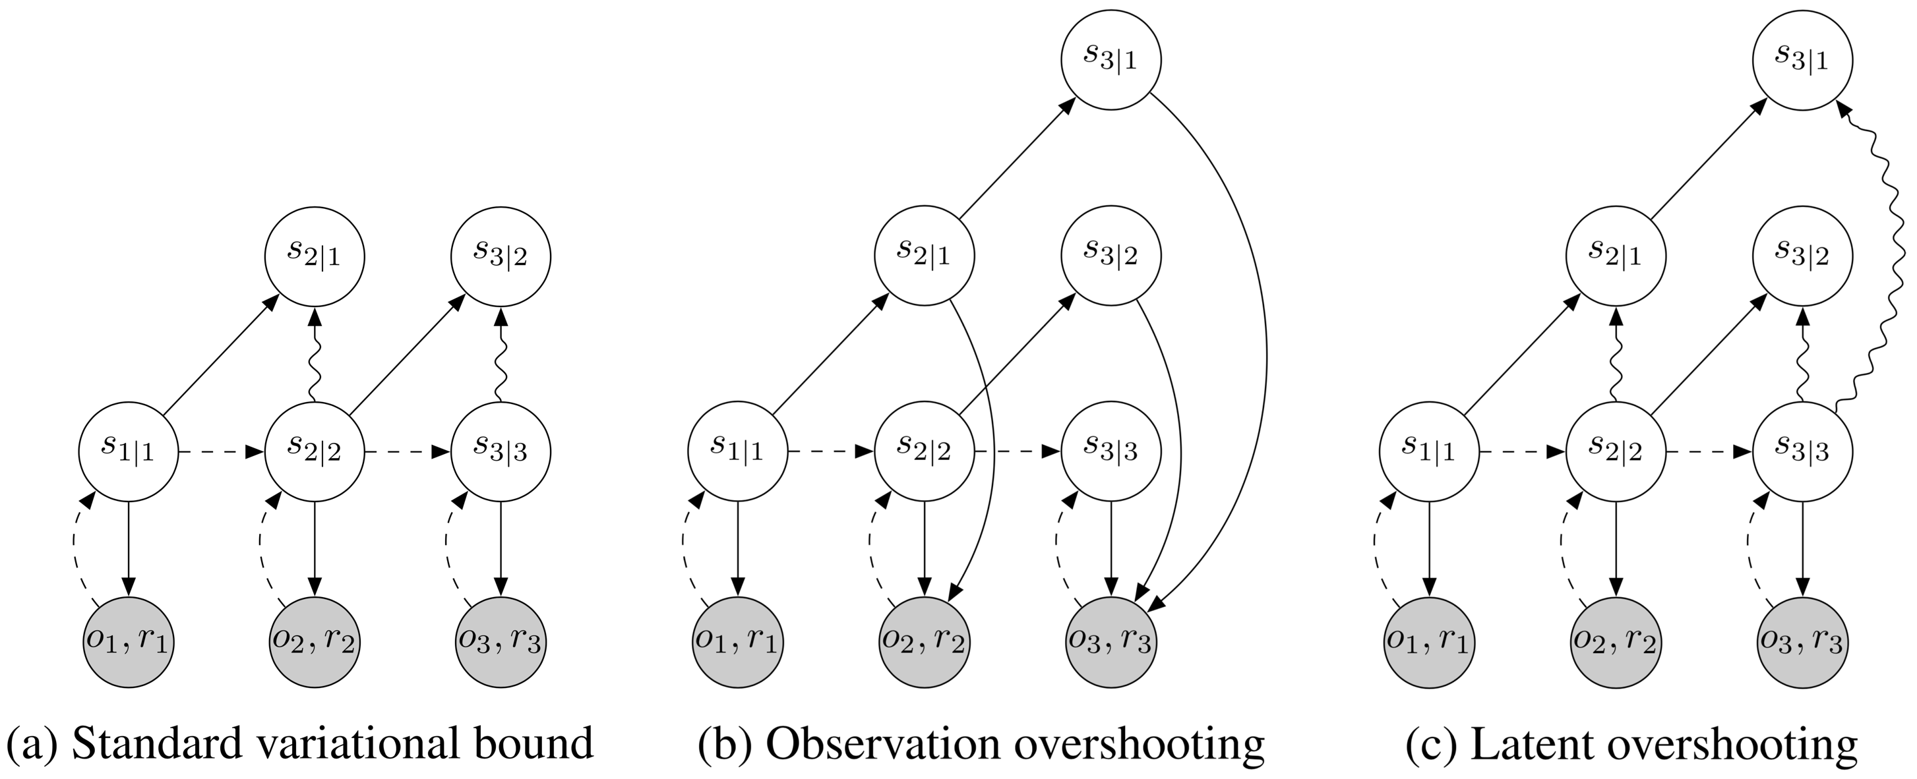
Latent OverShooting
Motivation
multi-step prediction은 추가 image를 가하지 않았을 때 latent space에서의 손실로 개선할 수 있다.

Slide 19
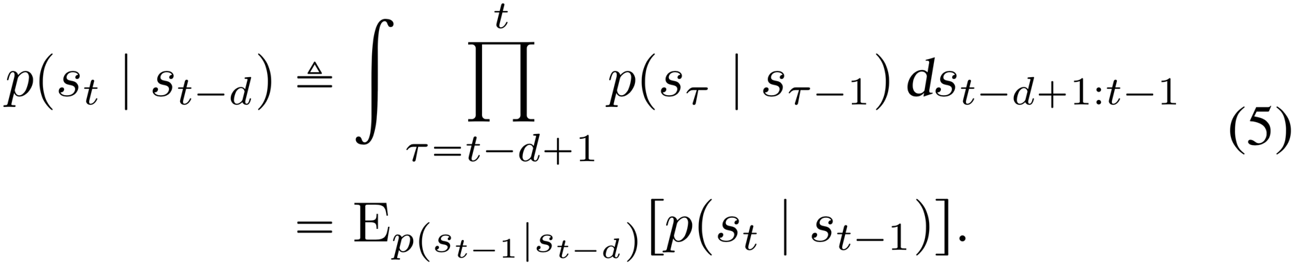
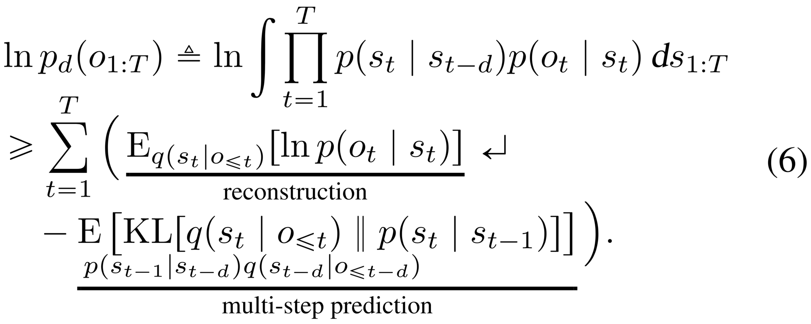
Latent OverShooting
■ Define Multi Step Prediction
d=1이면 1-step prediction
■ Objective Function (given distance d)
와 ~ Marcov하다 !

Slide 20
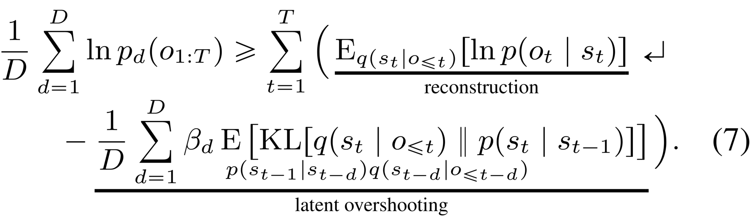
Latent OverShooting
■ Objective Function (all distances up to the planning horizon.)

Slide 21
Latent OverShooting
■ Objective Function (all distances up to the planning horizon.)

Slide 22
Experiments

Slide 23
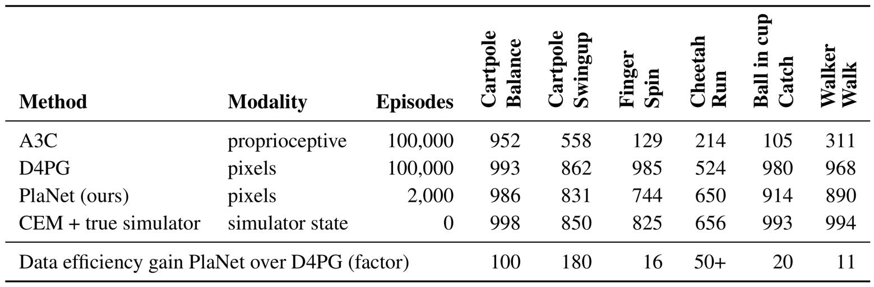
Comparison (Model-Free Method)

Slide 24
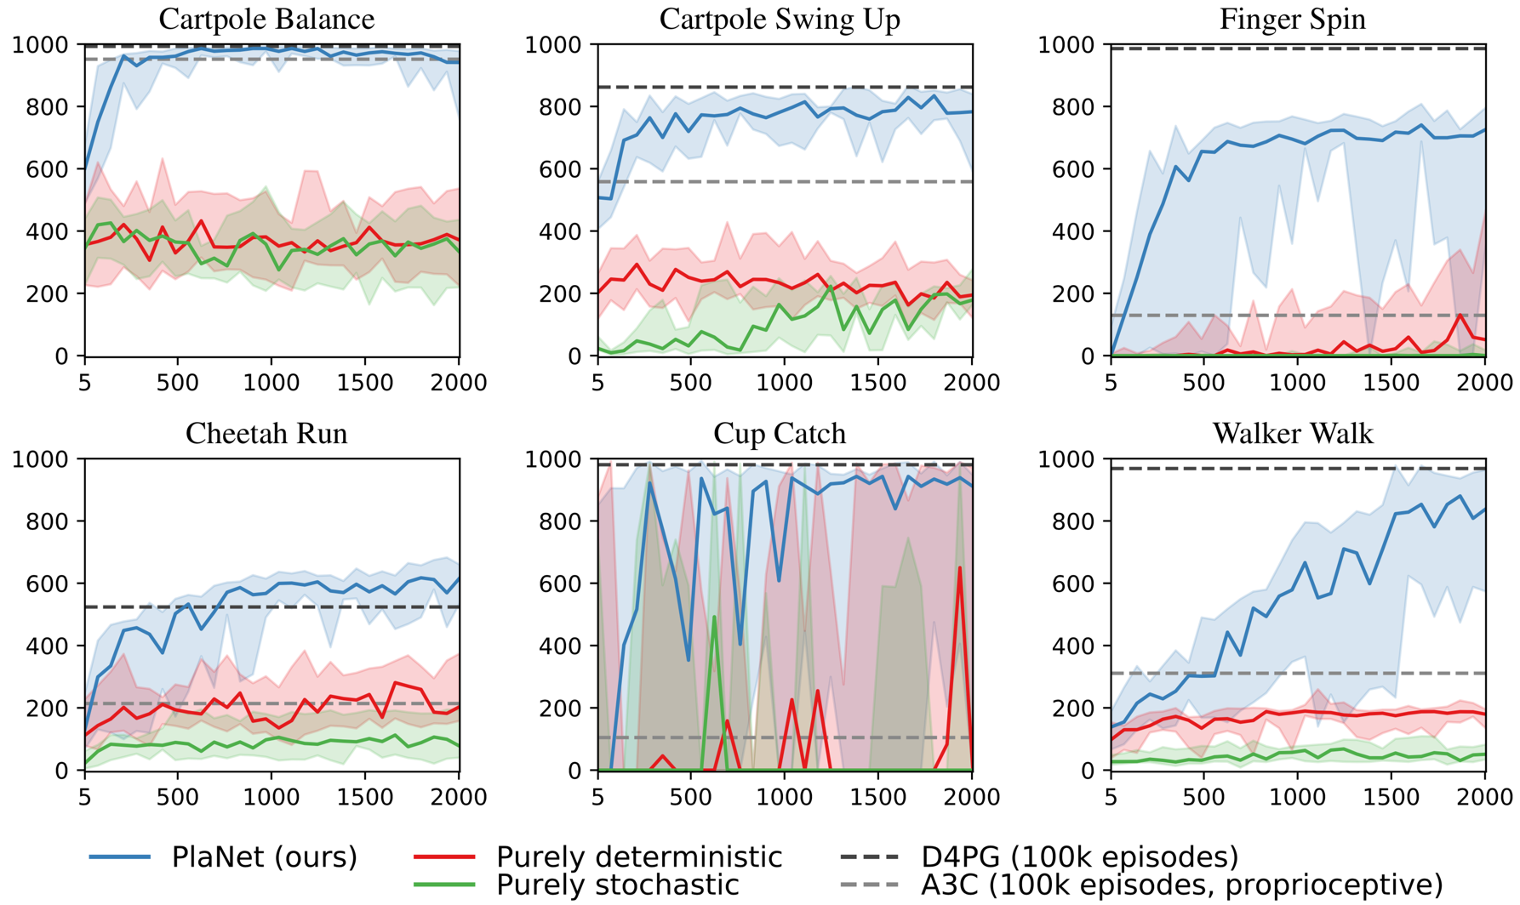
Model

Slide 25
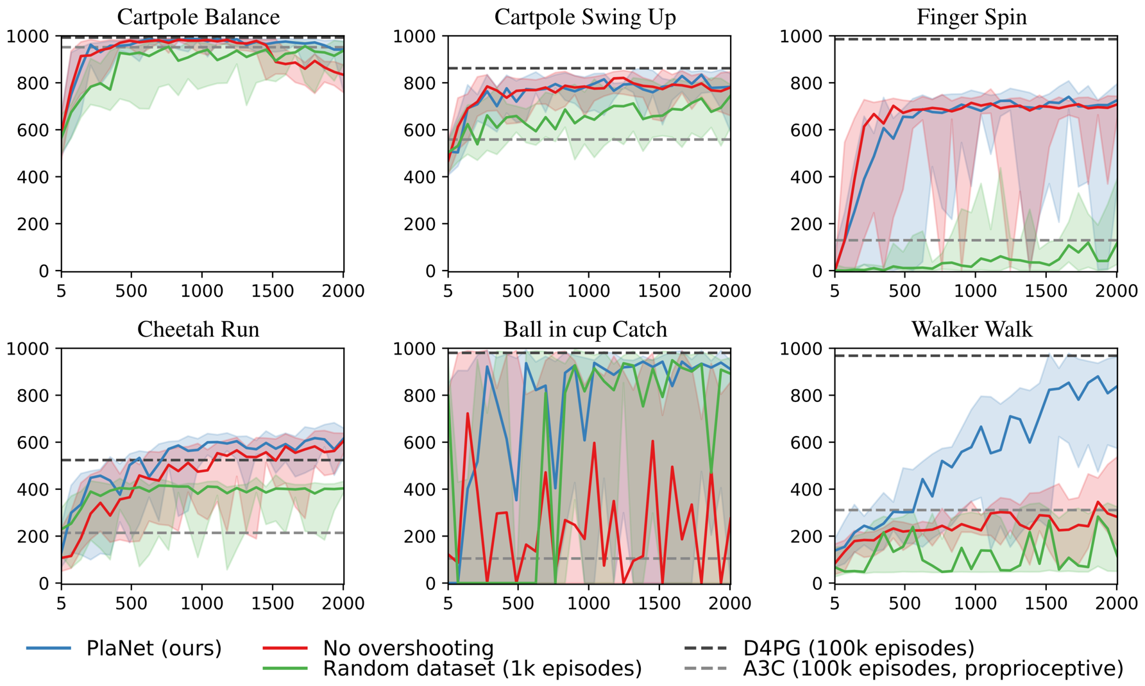
Agent

Slide 26
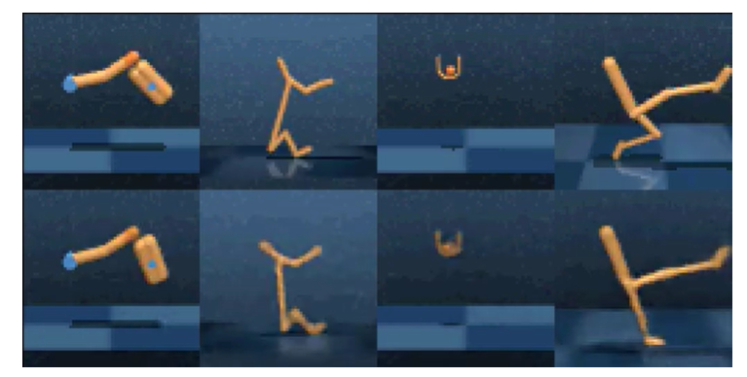
One agent all tasks
Episode
Prediction

Slide 27
Relative Works

Slide 28
Relative Works
Planning in state space
Hybrid agents
Multi-step predictions
Latent sequence models
Video prediction

Slide 29
End !

